Slide 1

Survey of Network Interfaces Form (SNIF)
IHE ITI Profile Proposal
28 October, 2019

Slide 2
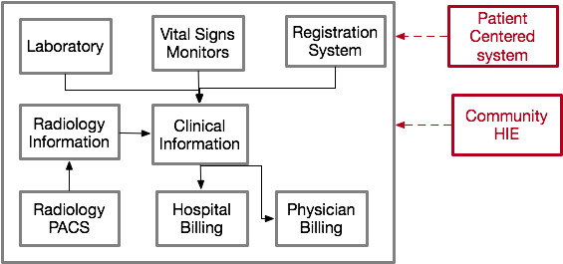
HealthCare Interfacing
How do new systems (represented in red) join this environment?

Slide 3

Interface Staffing
Hospitals hire consultants or temporary interface analysts
After install, interface staff is reduced to bare minimum
Knowledge is lost

Slide 4
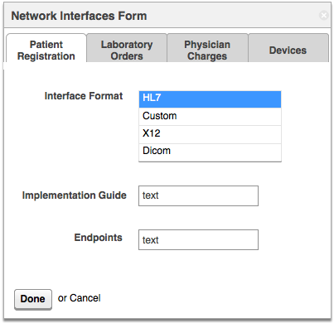
Proposal
Record the information when it is fresh
Machine readable
Make it available in a protected manner (certificates, web form, access controls)

Slide 5

How Does This Help?
The information remains with all the details that are known at installation.
Available (easy to find)
Consolidated
Standardized format

Slide 6
Solution
The new systems are granted access to the form and have access to all the details about the available information.

Slide 7
About the Form
The form can provide for granular information which allows the user to fill out only what they know. (For example, if they know they use an HL7 ADT interface but are not sure of the version).
Encourage users to be accurate rather than trying to fill in all the boxes, the absence of information is also good to have.
An xml form is discoverable by other software. New systems could read (sniff) the form and automatically connect based on the information.
The form also allows organizations an easy way to track information.
The form could have different levels of security , for example the basic list of interfaces, formats, versions, IG’s might be less secure than the actual connection points.

Slide 8
Why IHE?
Encourage use of one format to store the data.
Reminder to institutions to catalogue this information.
Gather community insights during the process of creating the profile and refining it.

Slide 9
Questions for Healthcare Delivery Organizations (HDOs)
How are interface endpoints catalogued today?
Who maintains the catalogue?
If an endpoint catalogue was standardized, would you adopt it?
Would you transition your current system to this one?

Slide 10

consistent, simple, usable

